Slide 1
Pre-Tax Contributions vs.
Roth Contributions
1

Slide 2
Benefits of Tax-Deferred Savings
The benefits of tax-deferred savings in a pre-tax 403(b) are...
Contributions, interest, dividends and gains
are exempt from current tax
Reduces current taxable income by
contribution amount
Pay tax only upon withdrawal - usually at
retirement when tax bracket is lower
2

Slide 3
The Spendable Pay Advantage – Pre 403(b)
403(b) Plan
Outside Plan
Gross Pay
$25,000
$25,000
403(b)
Contributions
$(1,250)
$0
Taxable Pay
$23,750
$25,000
Income Taxes
$(5,938)
$(6,250)
FICA Tax (7.65%)
$(1,913)
$(1,913)
Non-403(b) Savings
$0
$(1,250)
Spendable Pay
$15,899
$15,587
Increase in spendable pay:
$312
Assumes contribution of 5% of pay, 25% income-tax bracket, and married filing jointly.
3

Slide 4
Benefits of After-Tax Savings
The benefits of savings in an after-tax Roth 403(b) are...
Interest, dividends and gains are exempt from
current tax.
Unlike the pre-tax 403(b), contributions are made
with after tax dollars.
No taxes paid upon withdrawal – as long as the
money has been in the plan for 5 years and you
are age 59 ¹/₂ or older, disabled or deceased when
withdrawals are made.
4

Slide 5
Pre-tax or Roth Contributions?
The decision depends on your personal situation.
Considerations include:
Current age
Expected retirement tax bracket
Expected retirement age
Amount of contributions
Current tax bracket
Consult a professional advisor to make a decision
best suited to your needs.
No matter what, deciding to save is the key!
5

Slide 6
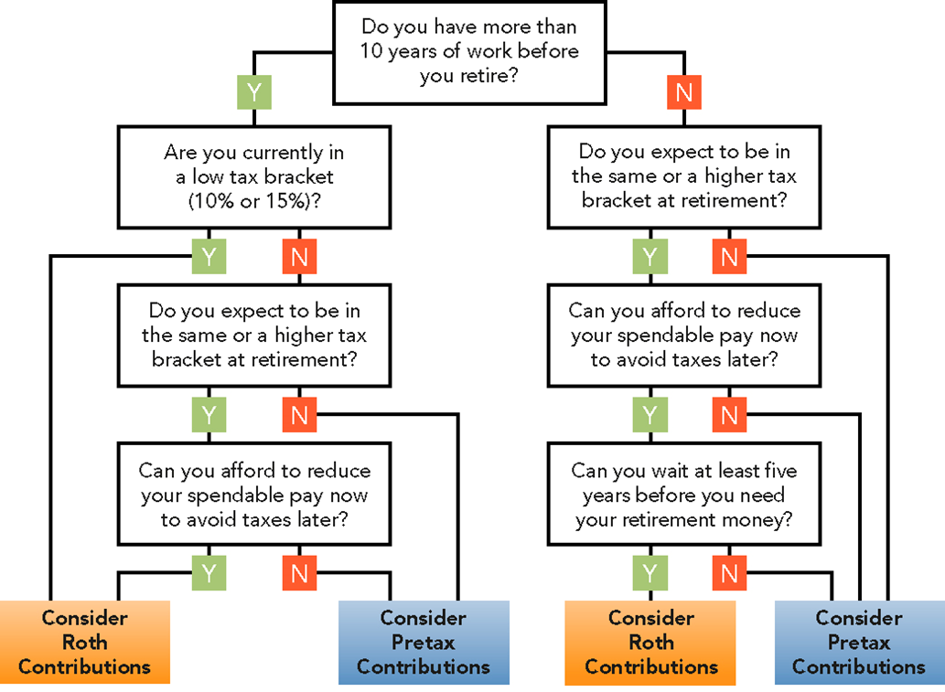
Which Route Is Best For You?

Slide 7
People’s United Wealth Management
Important Disclosures
Investments and assets held in a fiduciary account are not deposits, or other obligations, are not guaranteed by People’s United Bank, N.A., are not insured by the FDIC, by any other government agency, or by People’s United Bank, N.A., or any of its affiliates, and may lose value.
Member FDIC.
7

